Slide 1
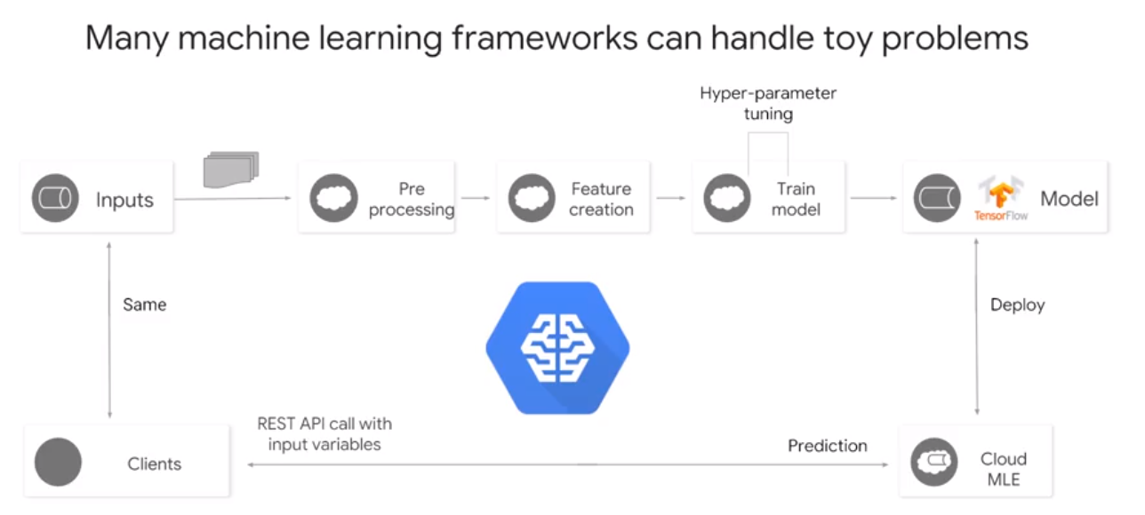
ML concept
Machine Learning
OK model for large amount of data is better than Perfect model for small data. WHY?
Training data might be too big to memoery
sharped

Slide 2
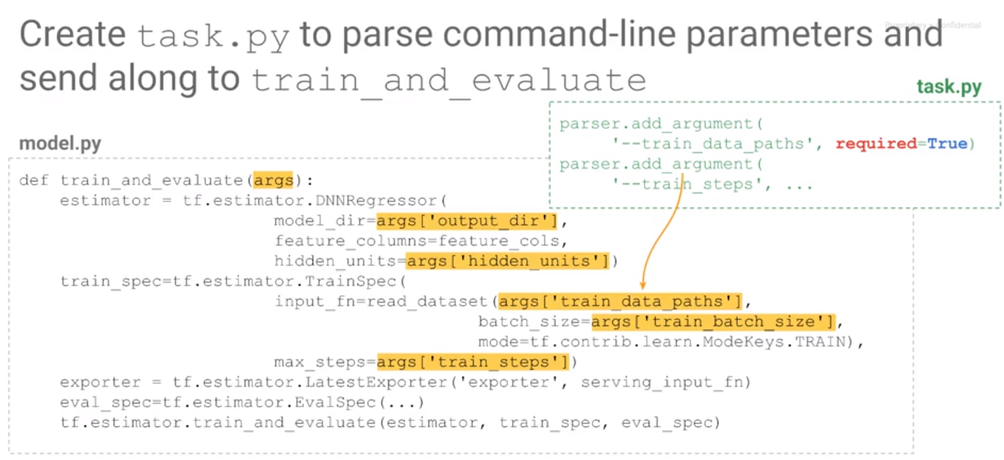
ML concept
Machine Learning
When sending jobs to Cloud ML engine task.py : entry point as a star and ignores job-level details like how to parse a command line argument,
how long to run, where to write the outputs,
how to interface hyperparameter tuning,
which invoke model.py

Slide 3
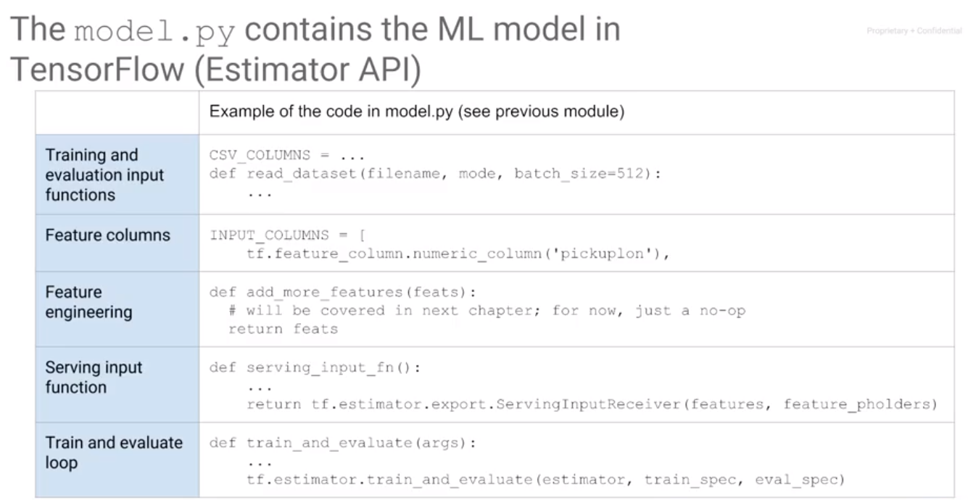
ML concept
Machine Learning
model.py
focuses more on the core machine learning tasks,
like fetching the data, defining features,
configuring the service signature,
and, of course, the actual train and evaluate

Slide 4
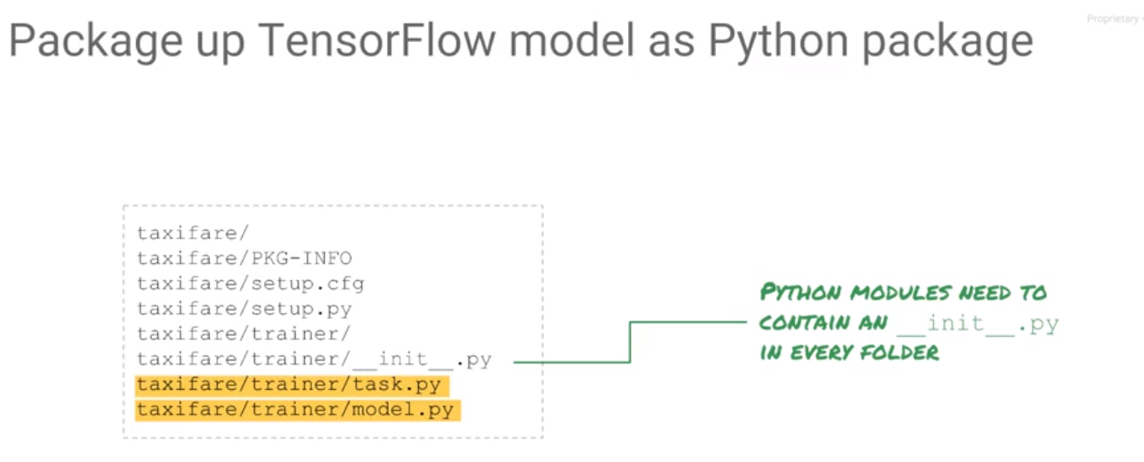
ML concept
Machine Learning

Slide 5
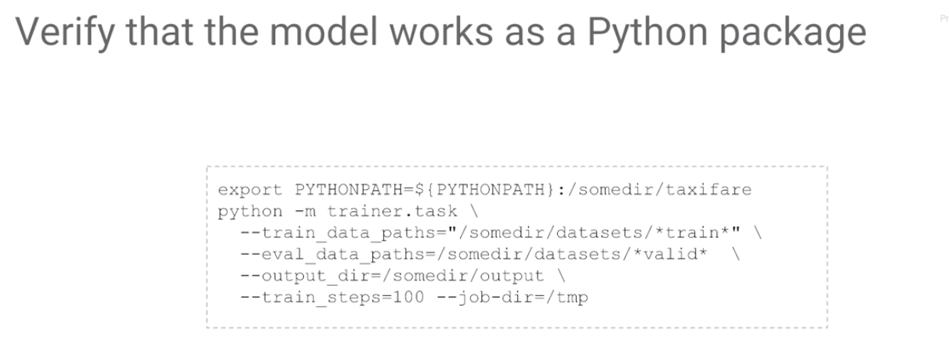
ML concept
Machine Learning

Slide 6
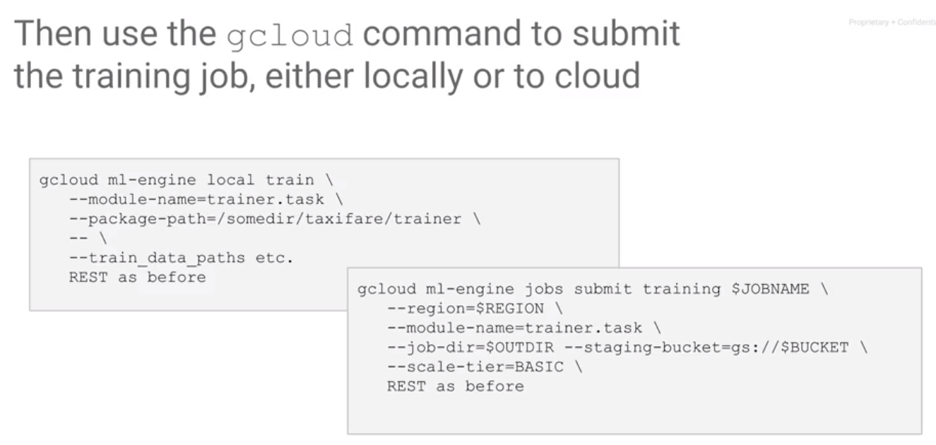
ML concept
Machine Learning
locally
On the Cloud

Slide 7
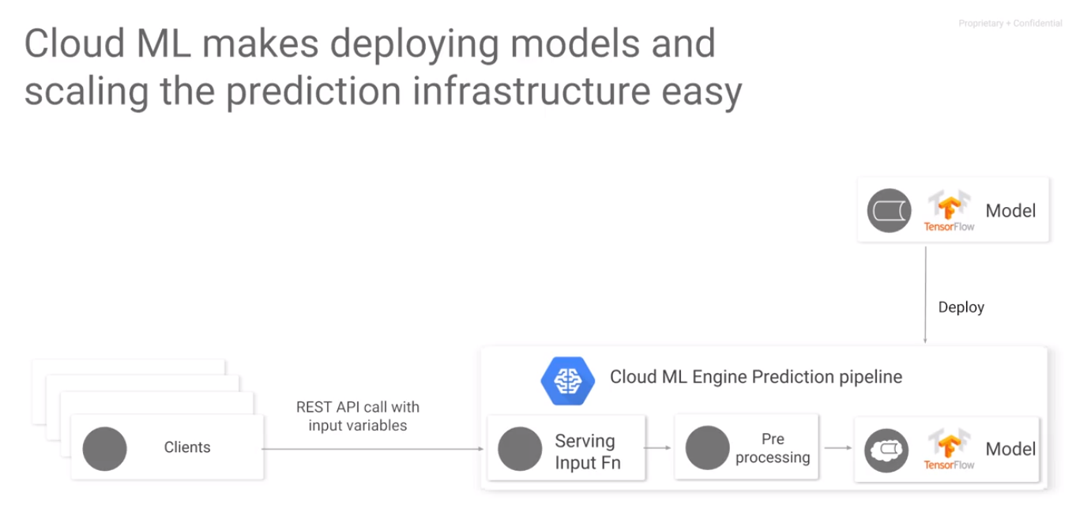
ML concept
Machine Learning
REST API is a auto scale and fully management API
,which is suitable for JSON file,for deploy model on the cloud

Slide 8
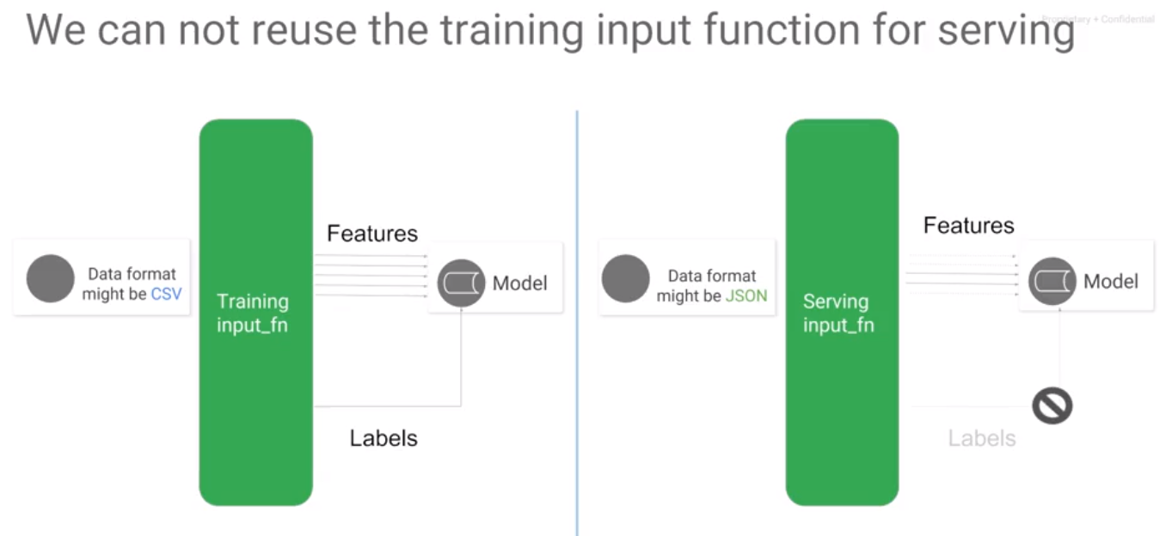
ML concept
Machine Learning
Cloud ML engine also support both batch and online prediction Delpoy ur model on the cloud with a Serving input_fn since ur model might not only fit JSON file ,input for training/testing but not only for JSON file,
Serving input_fn doesn’t need labels, it will generate labels from JSON format file

Slide 9
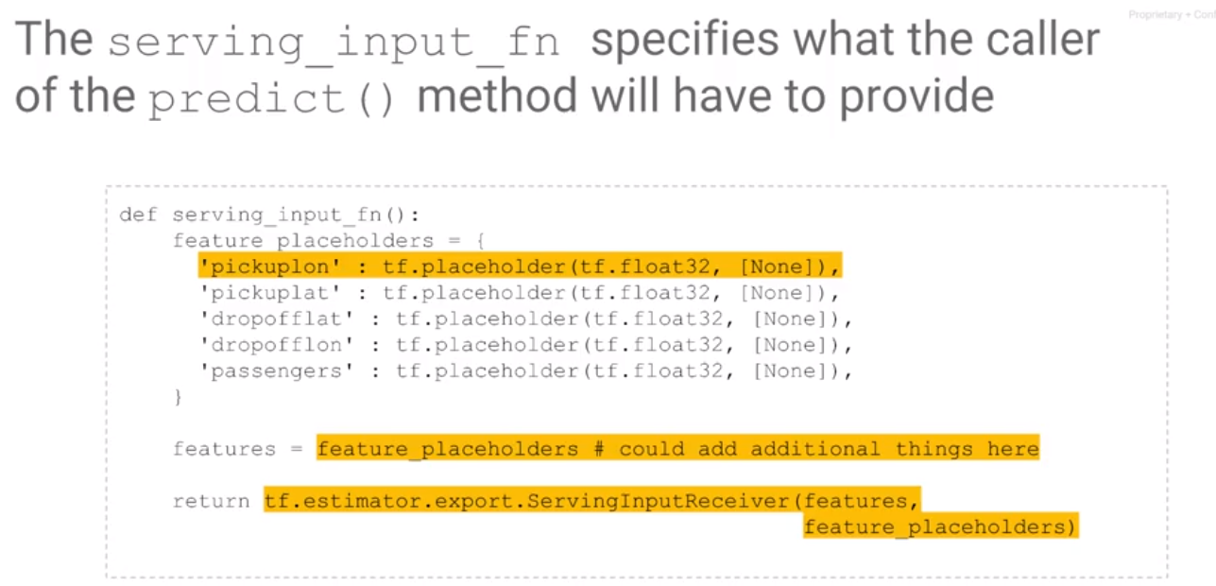
ML concept
Machine Learning
Features are still expected from the model

Slide 10
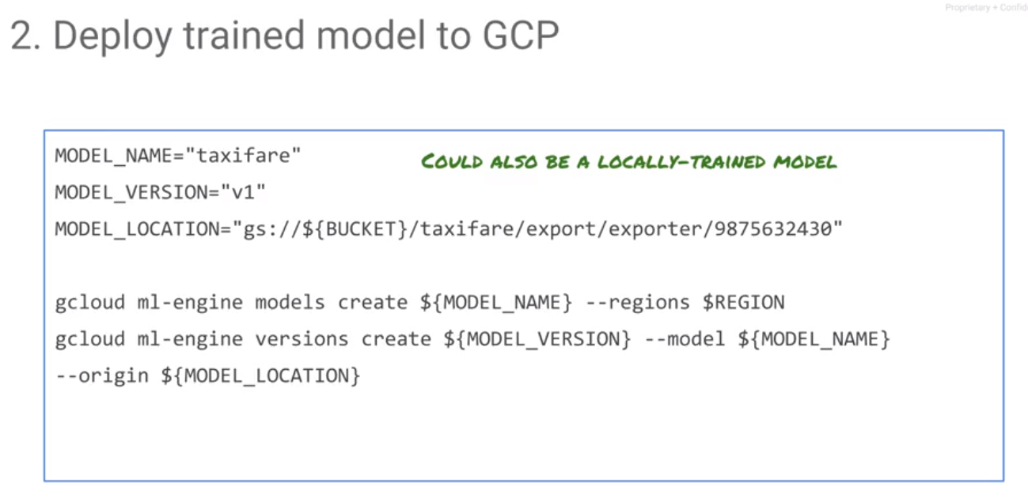
ML concept
Machine Learning

Slide 11
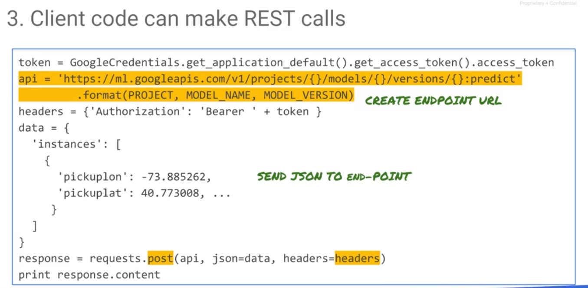
ML concept
Machine Learning

Slide 12
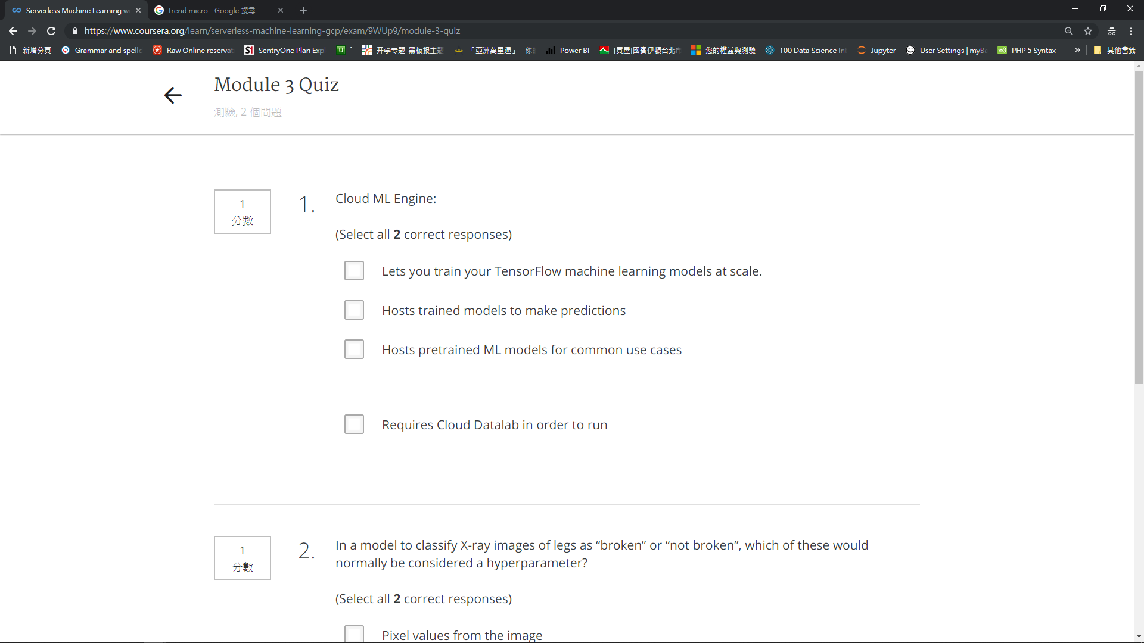

Slide 14
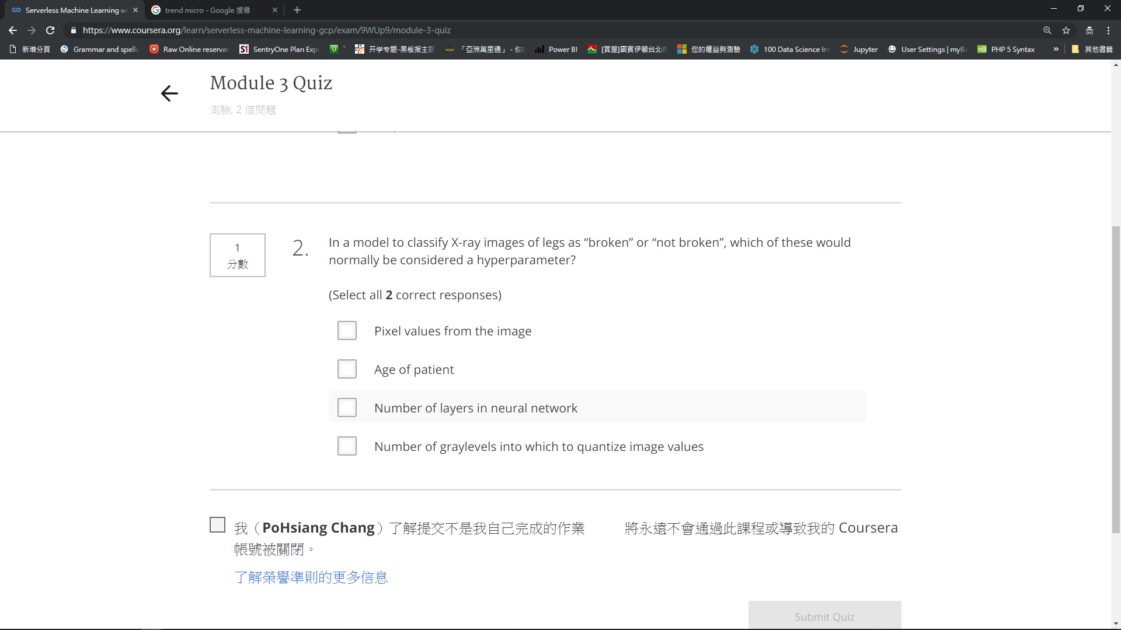

Slide 16
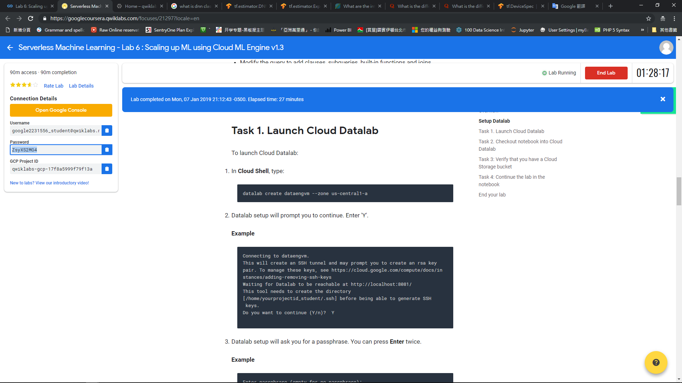

Slide 17
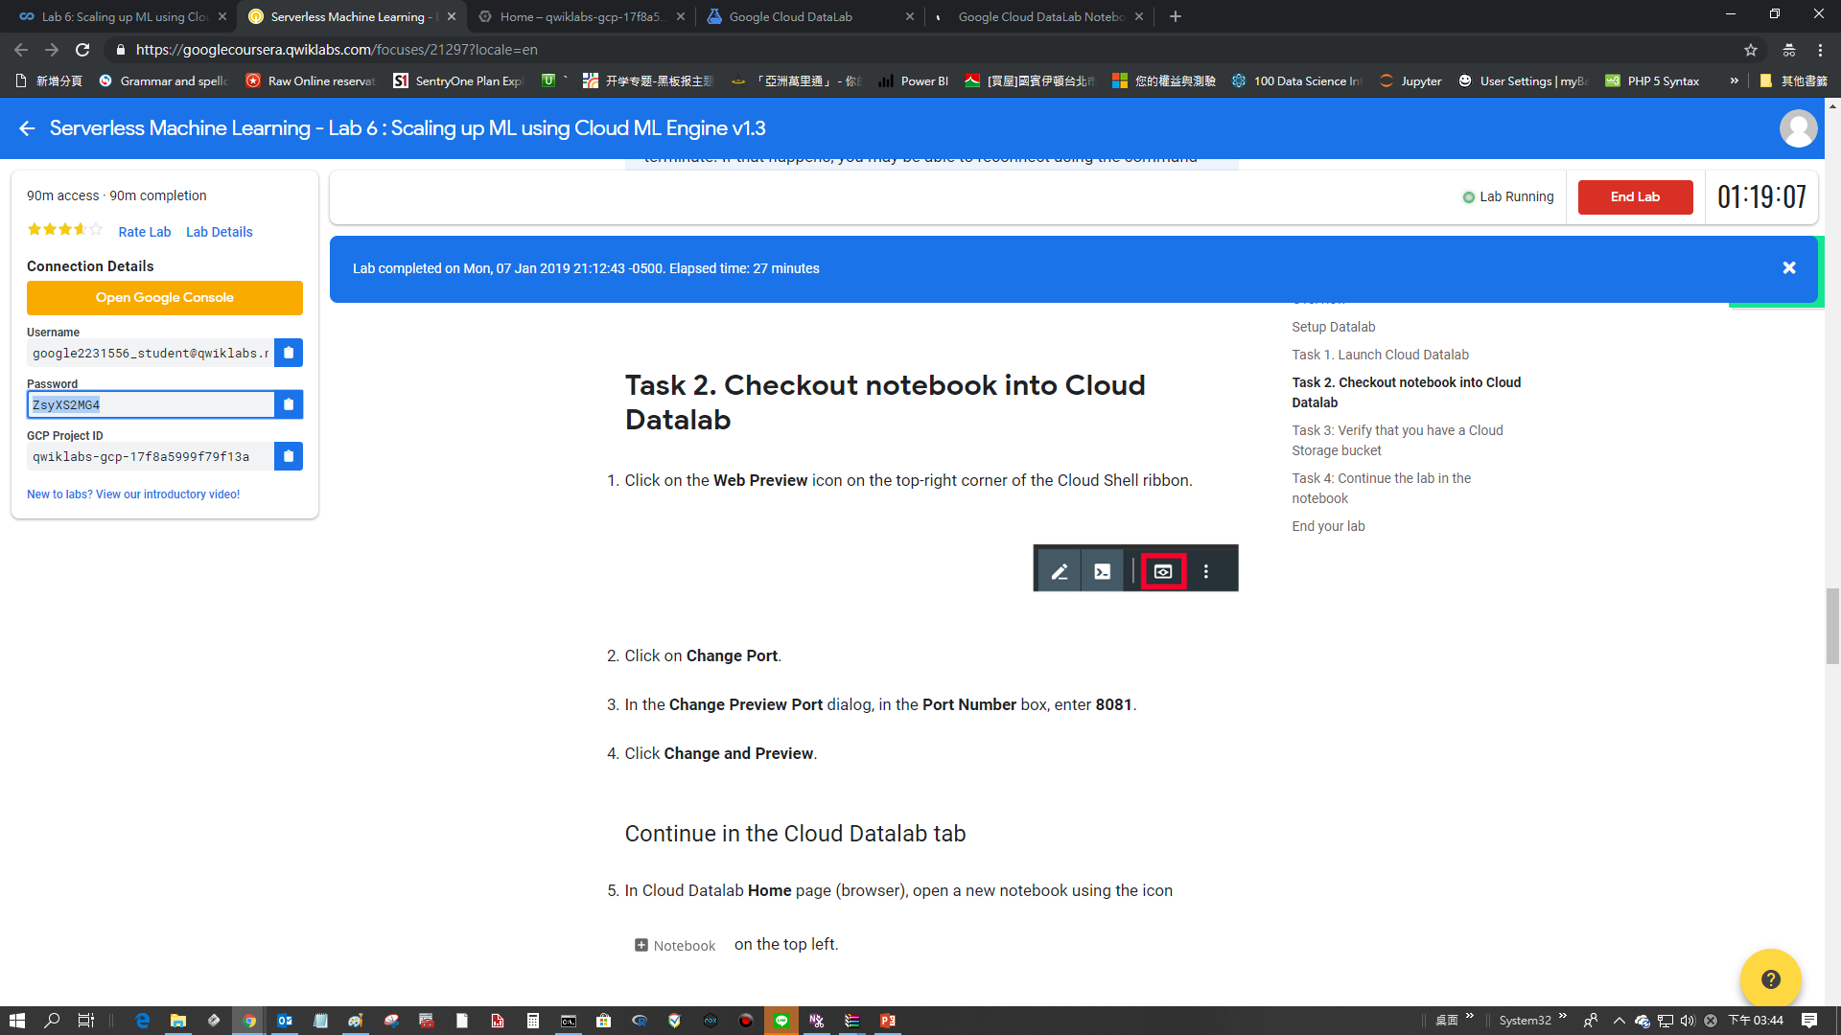

Slide 18
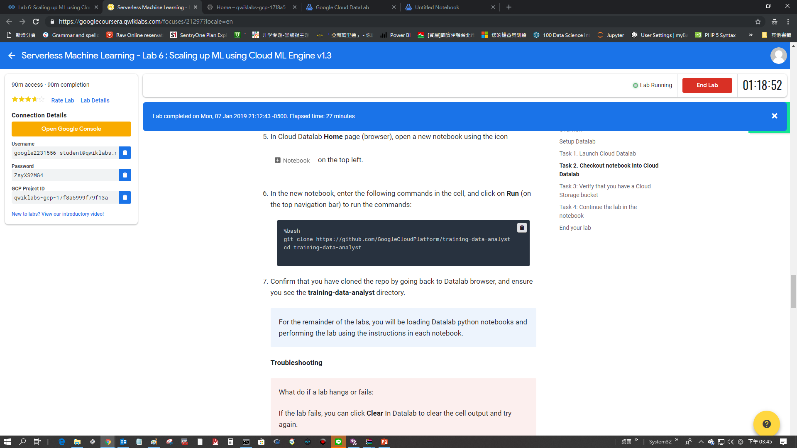
%bash git clone https://github.com/GoogleCloudPlatform/training-data-analyst cd training-data-analyst

Slide 19
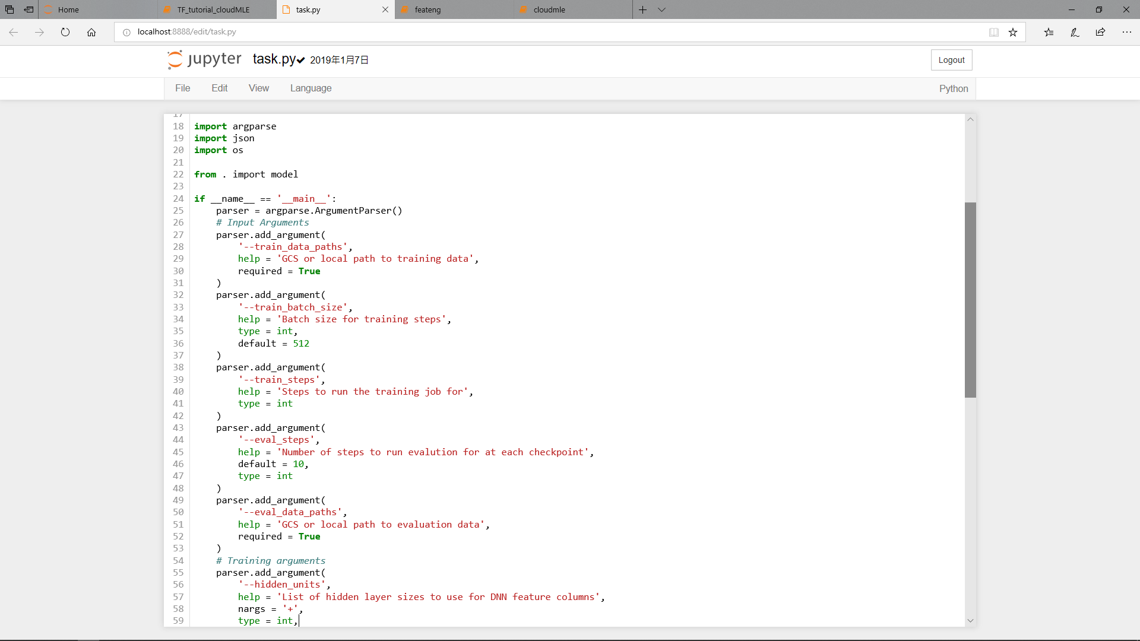

Slide 20
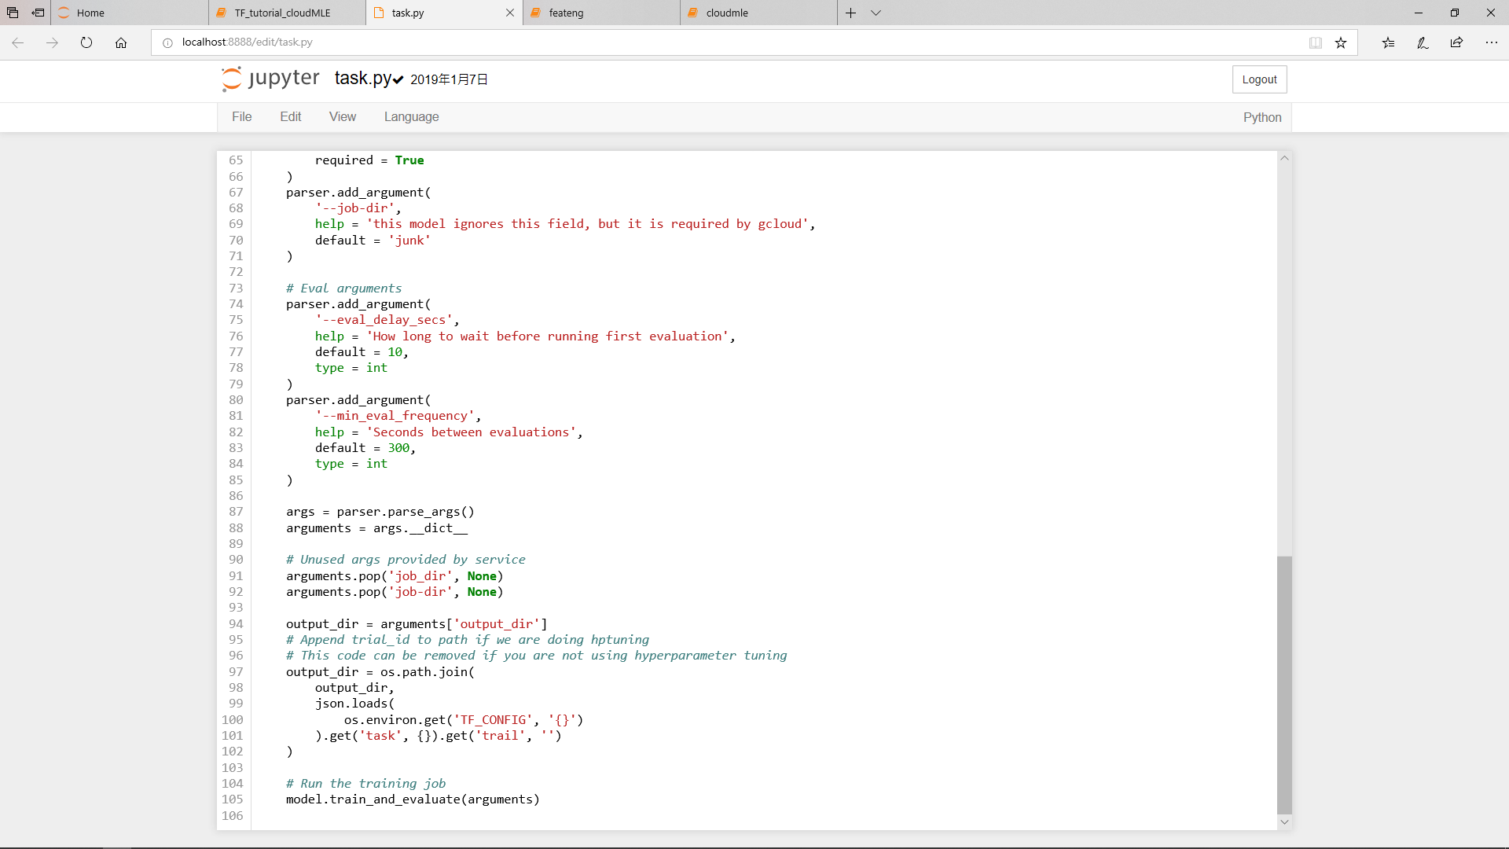
In hyperparameter tuing, trial data will be separated to this class
Train_spec, Eva_spec

Slide 21
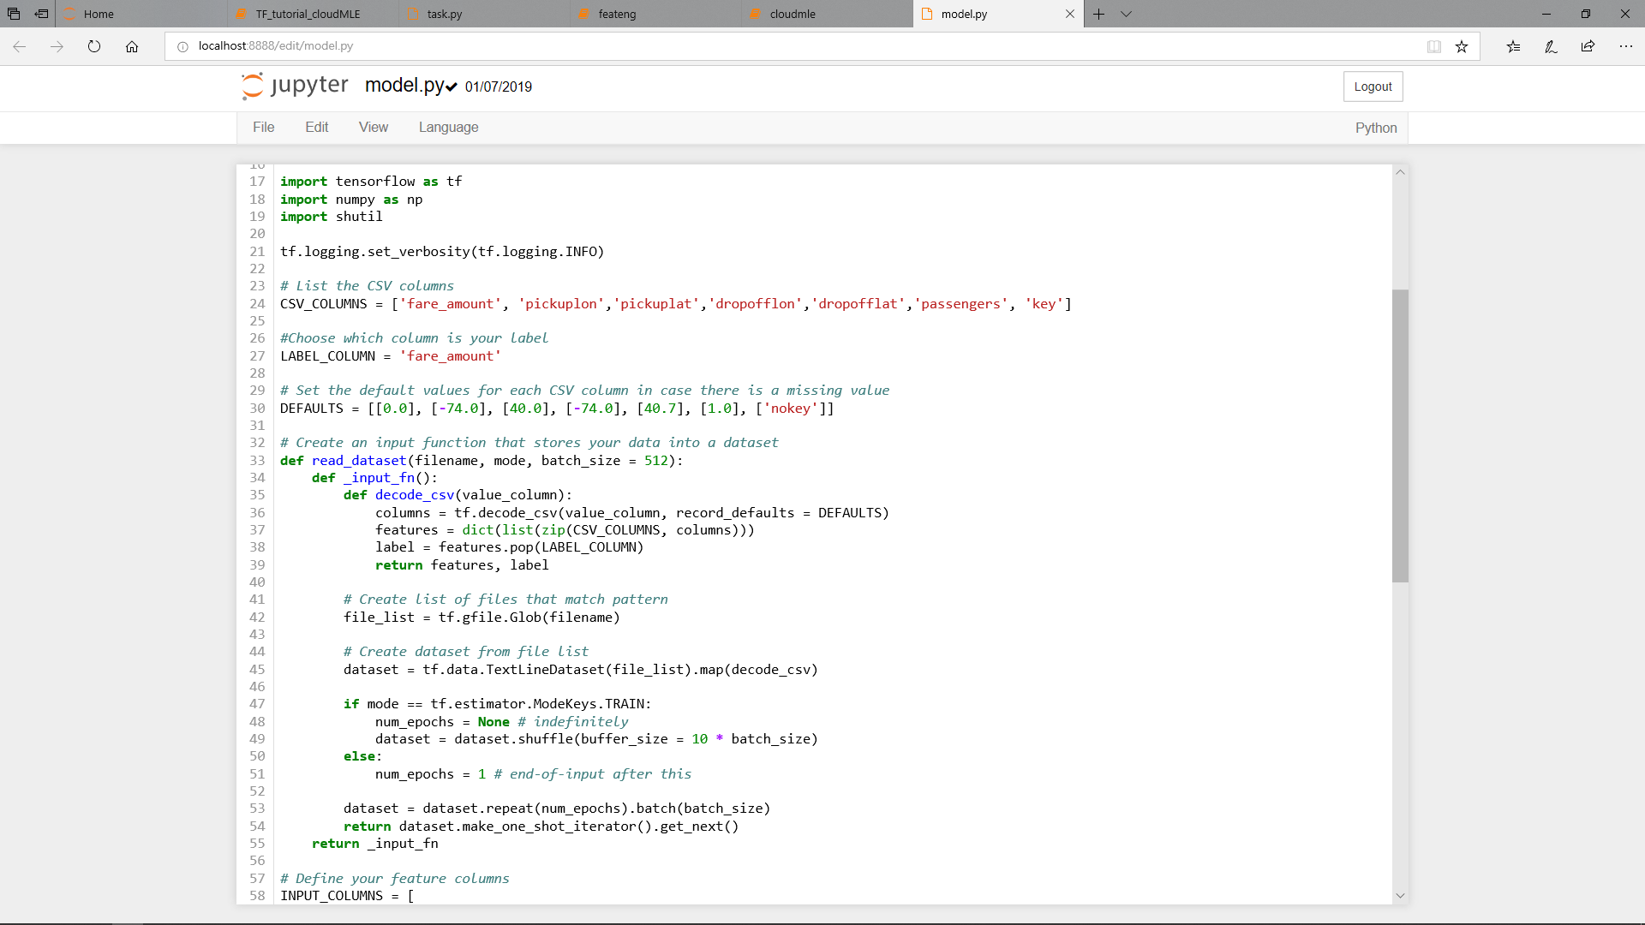

Slide 22
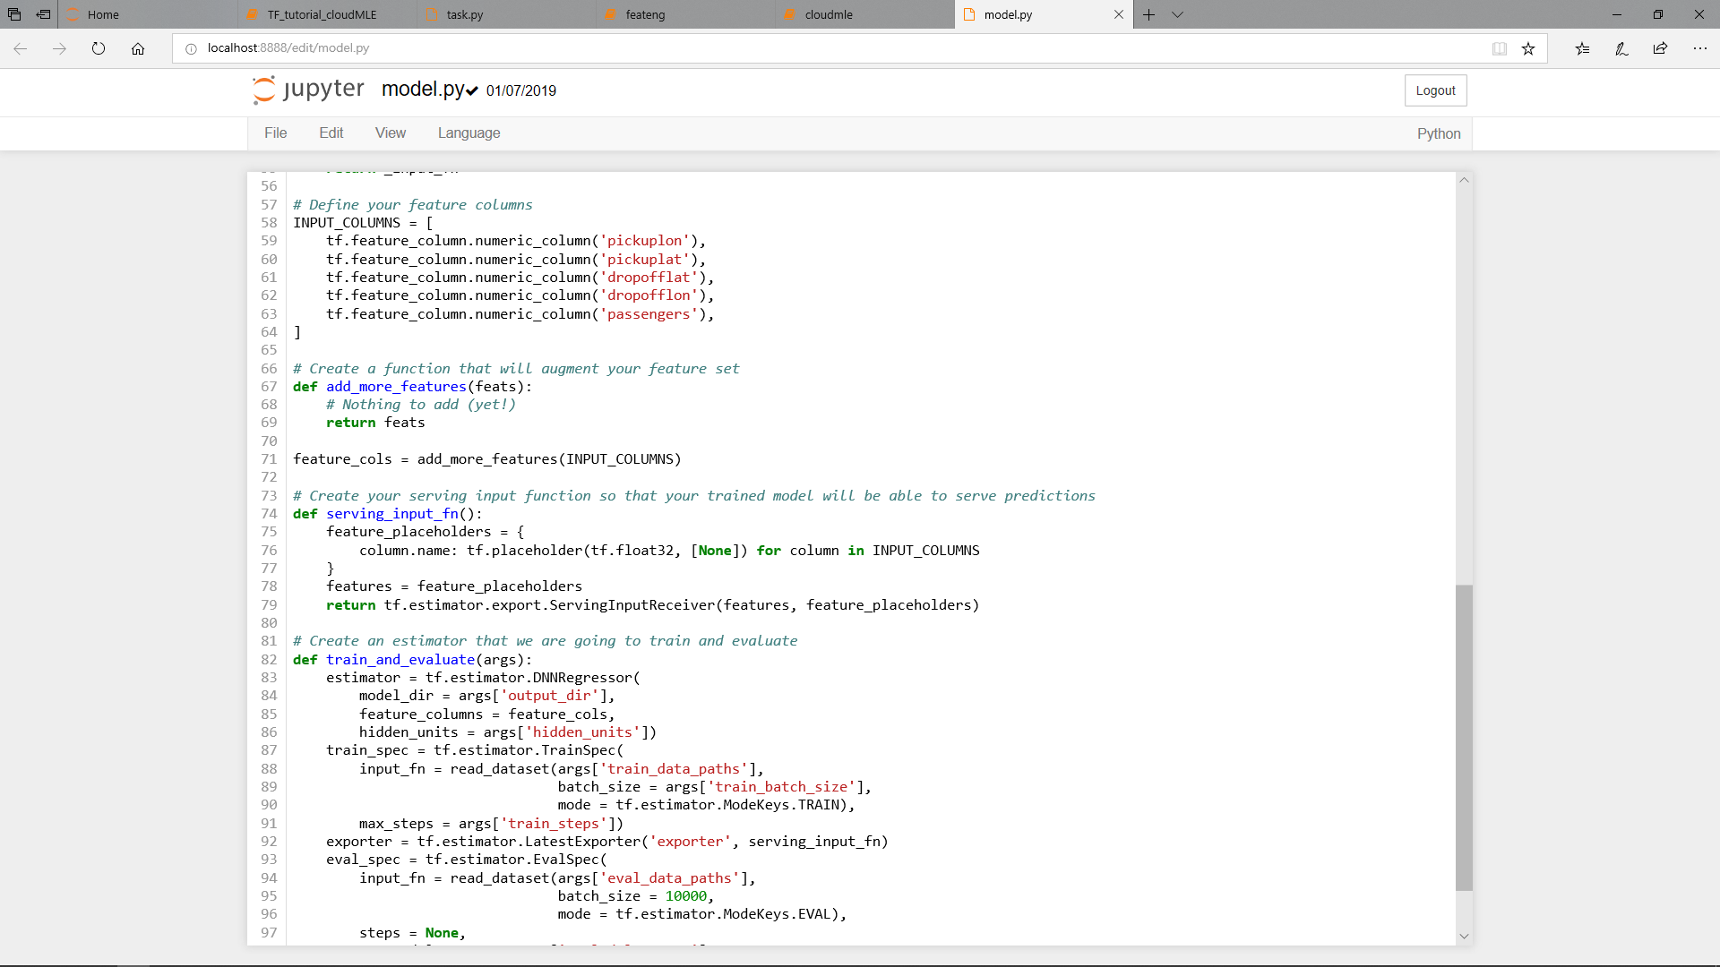

Slide 23
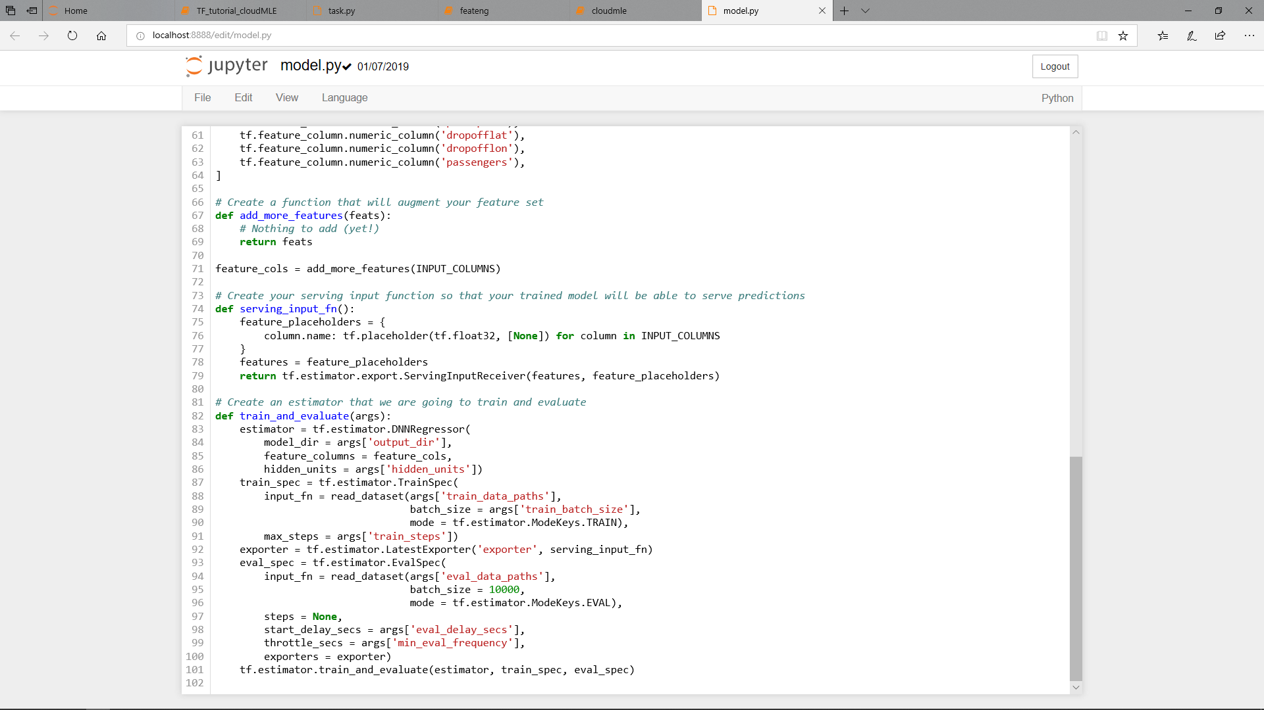

Slide 24
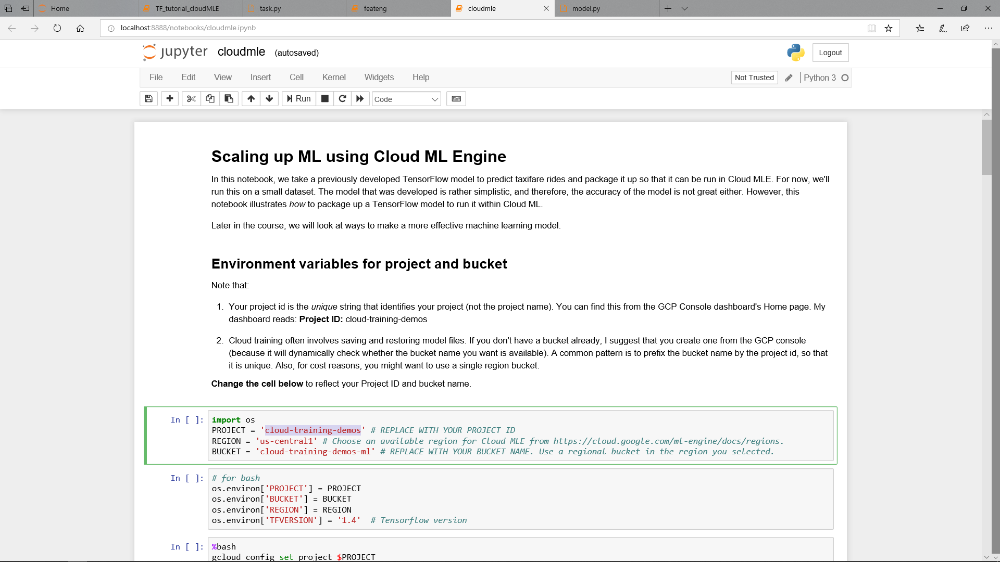
Replace GCP projectID, Region, Bucket

Slide 25
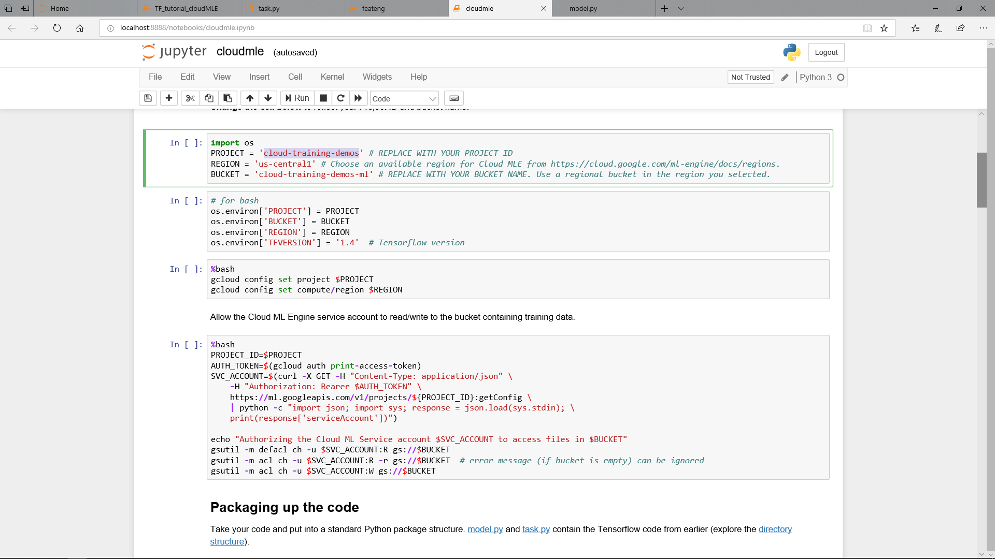
Give cloud ML permission to execute

Slide 26
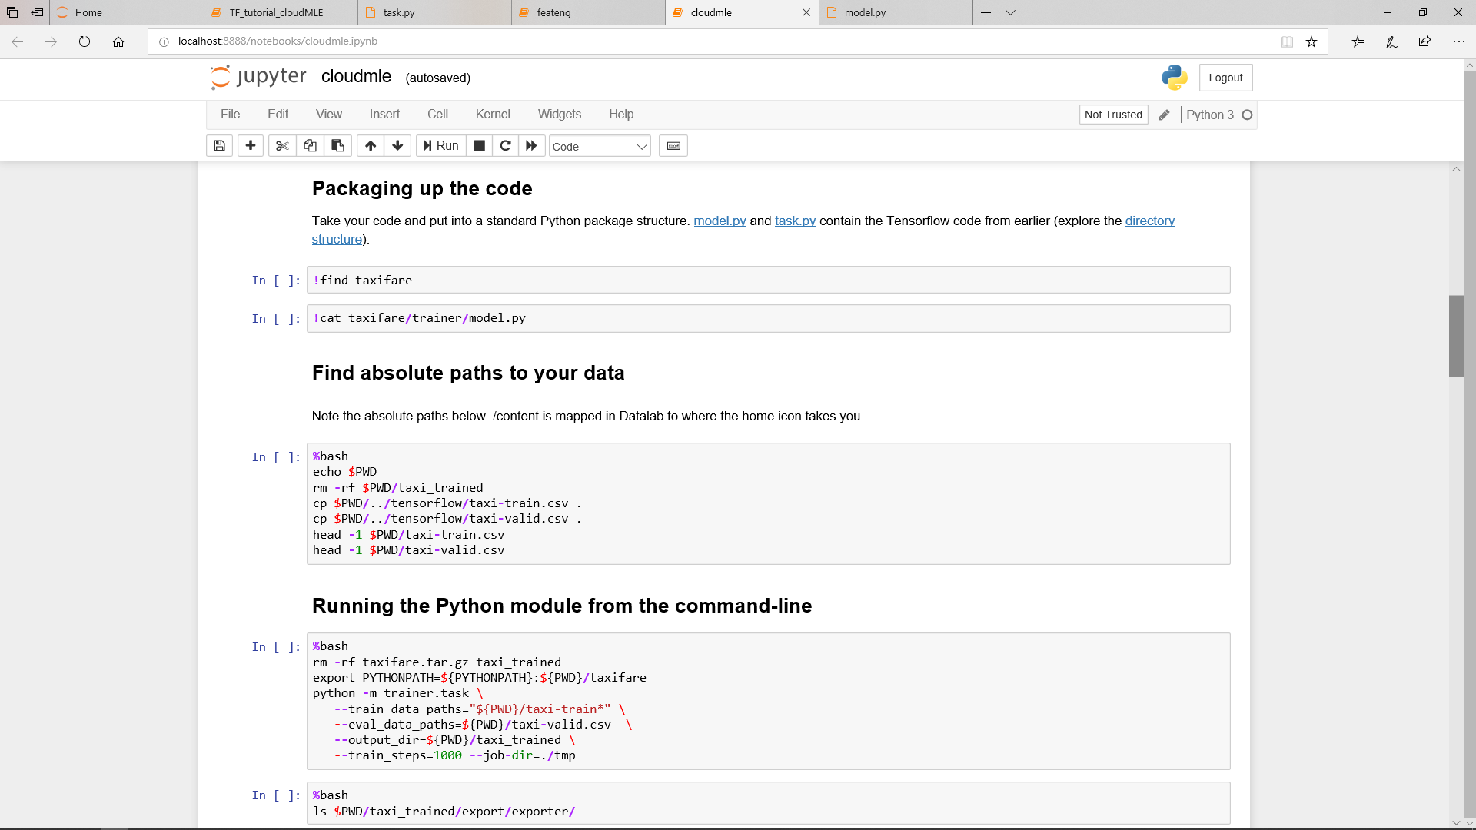

Slide 27
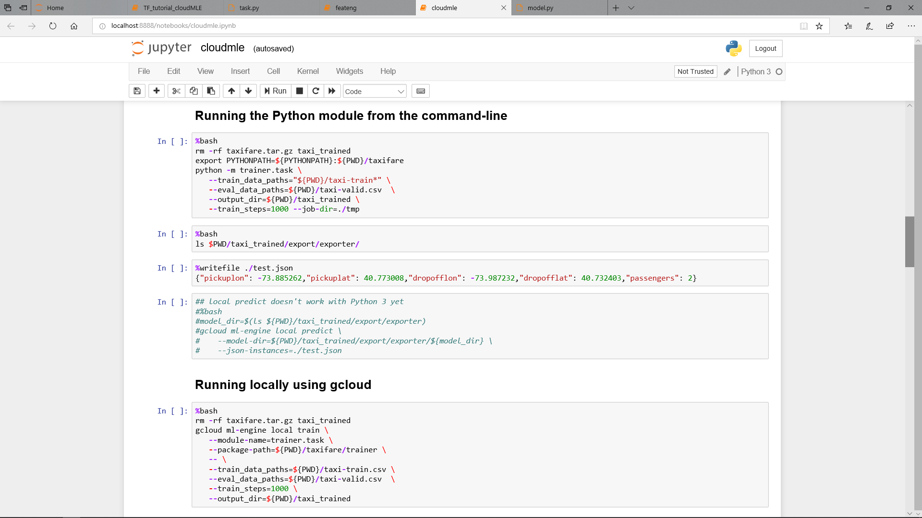

Slide 28
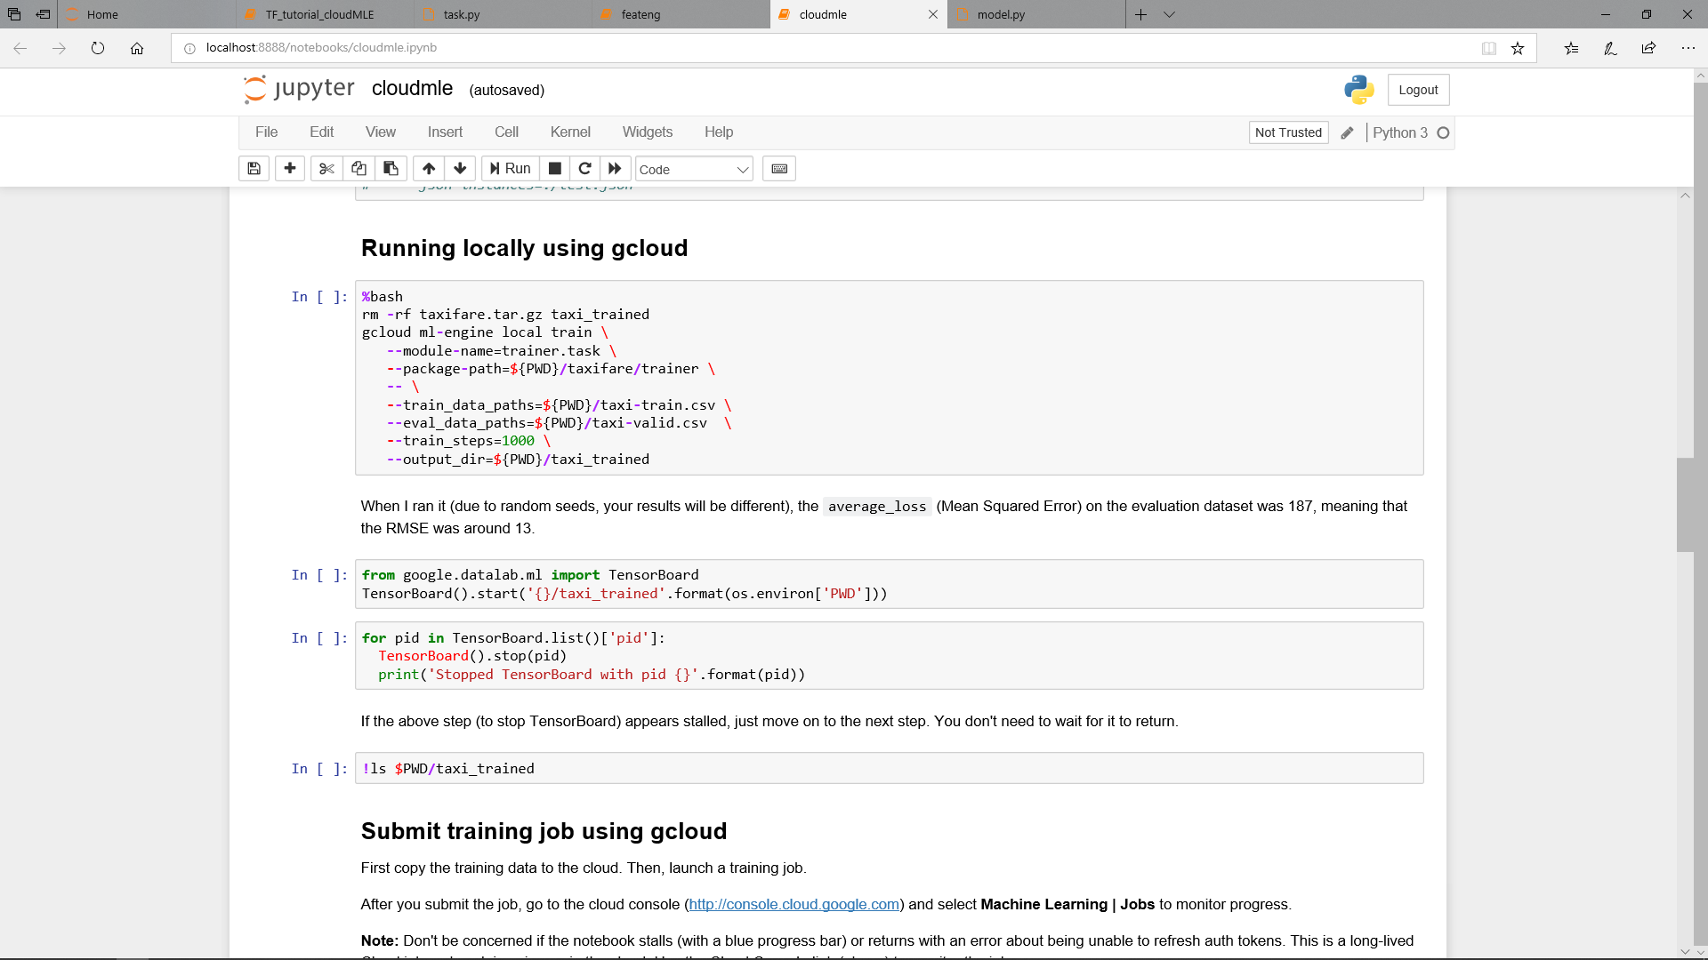

Slide 29
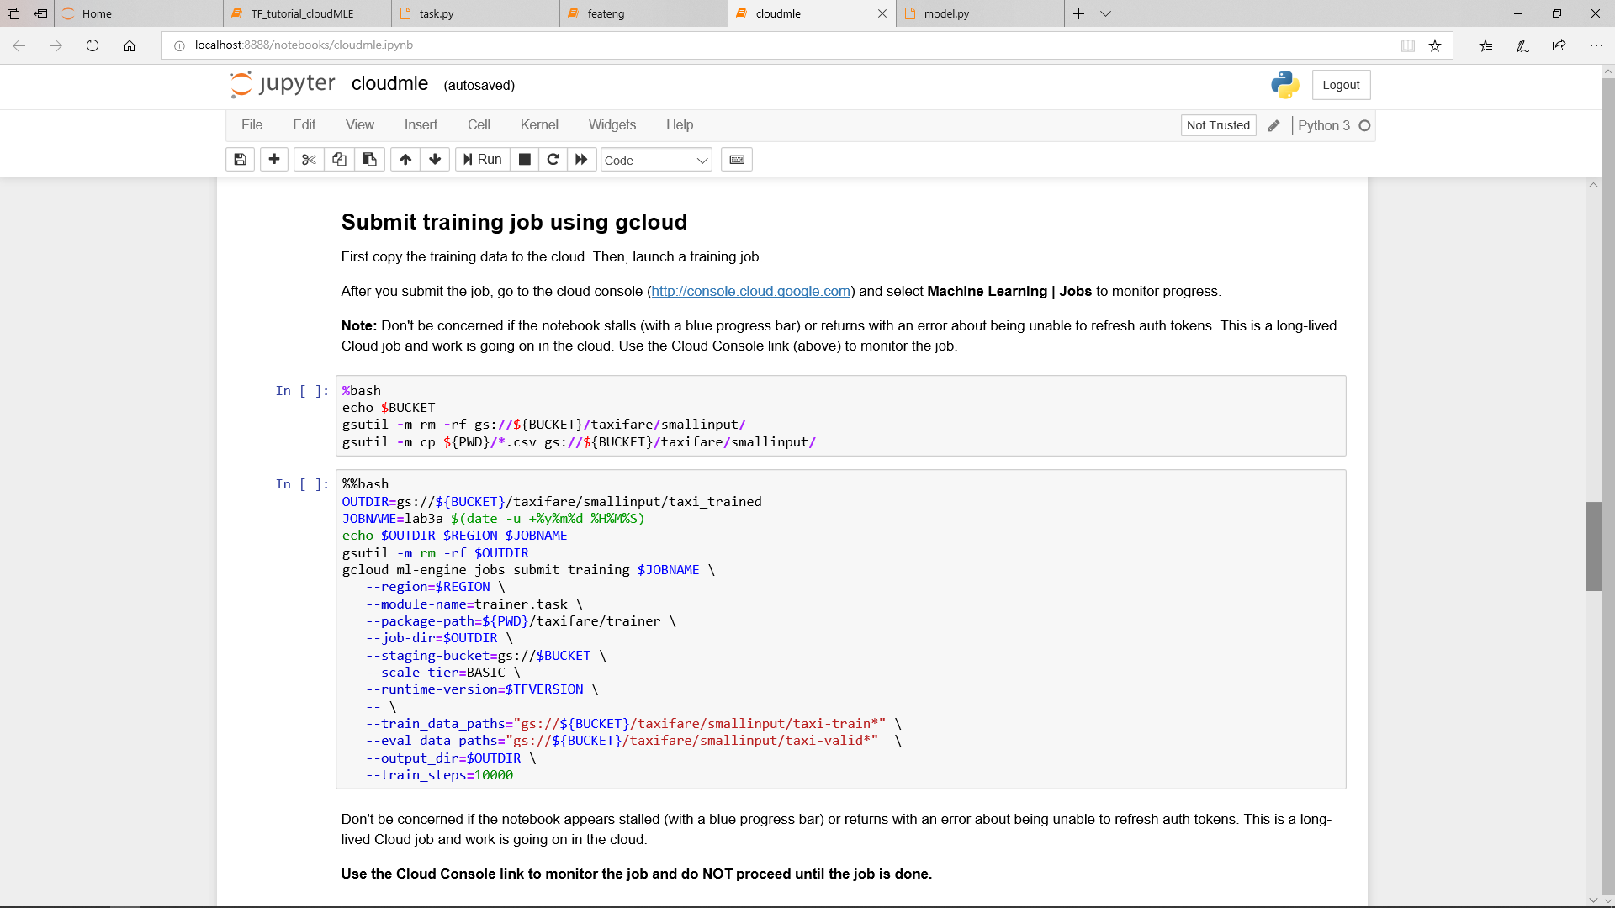

Slide 30
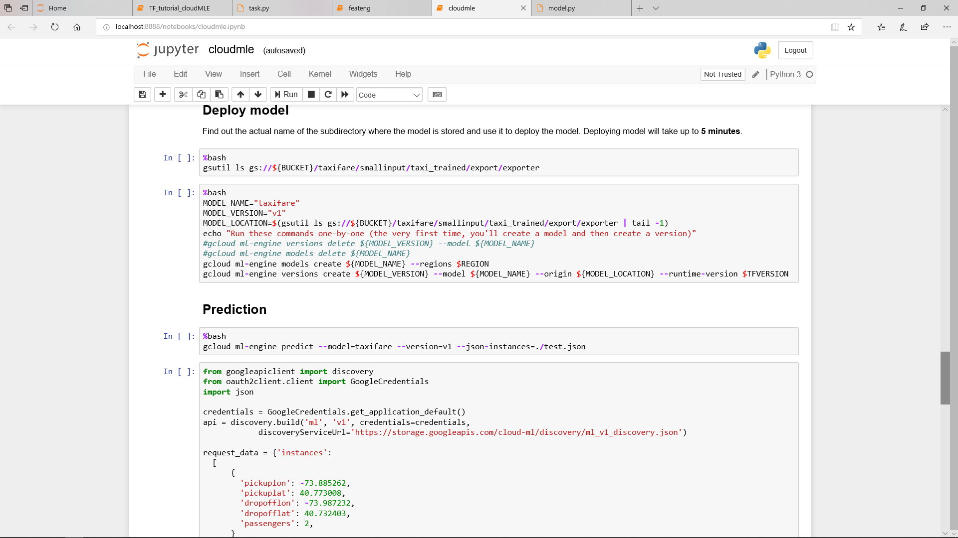

Slide 31
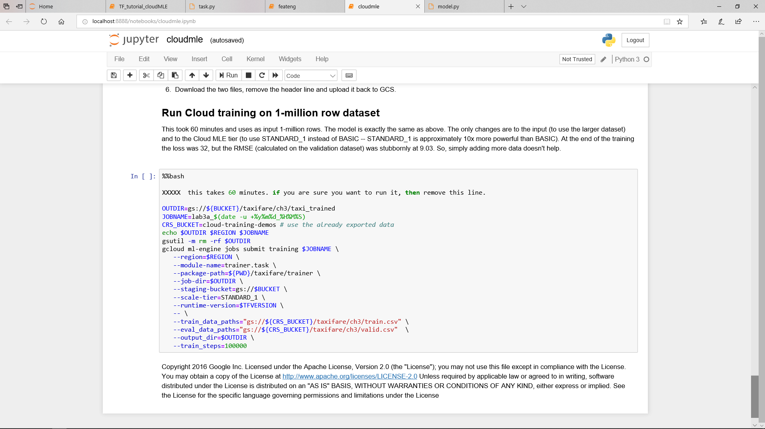

Slide 32
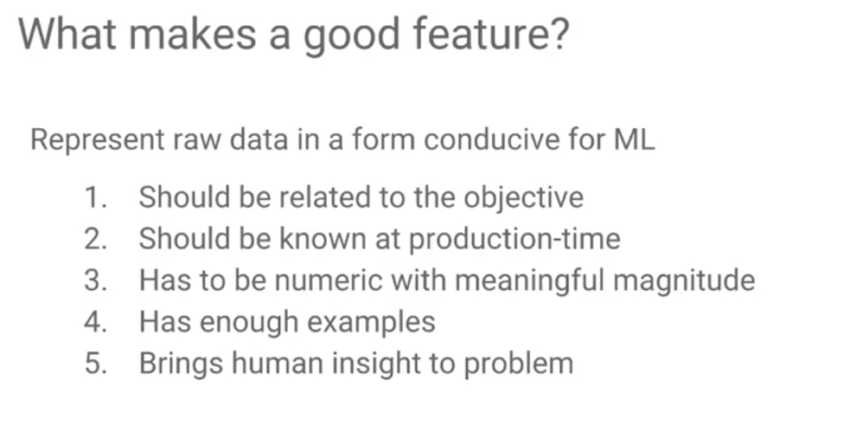
ML Feature Engineering
Machine Learning
Time Factors

Slide 33
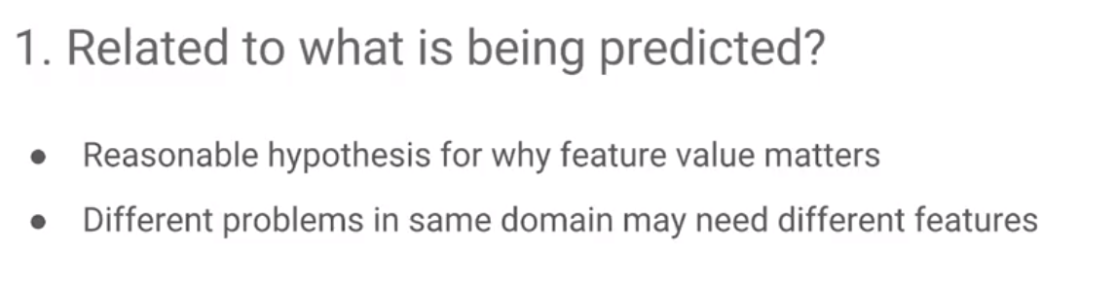
ML Feature Engineering
Machine Learning

Slide 34
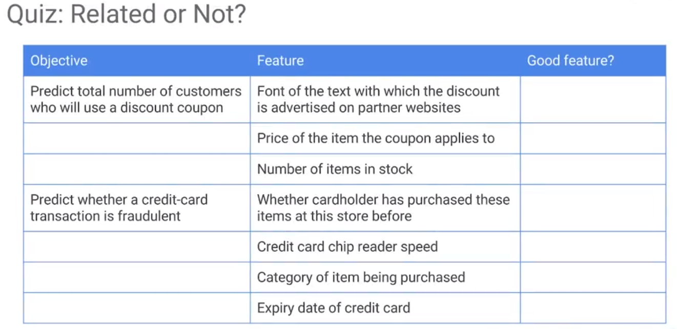
ML Feature Engineering
Machine Learning

Slide 35
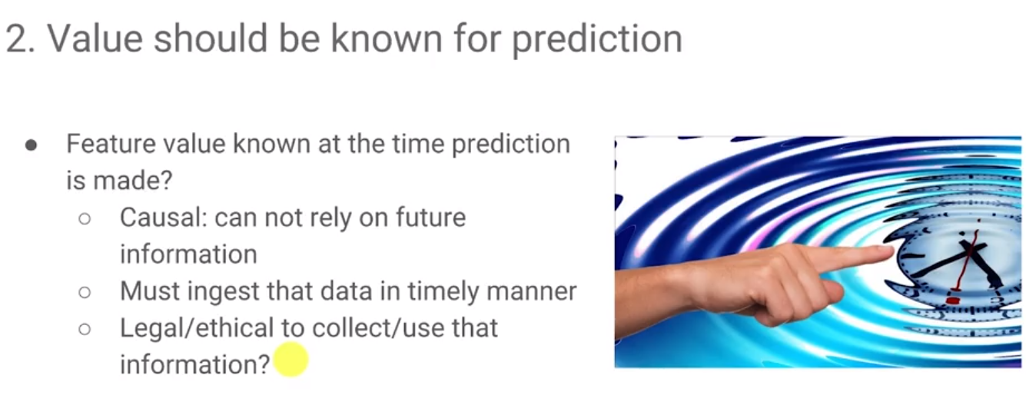
ML Feature Engineering
Machine Learning
Train data up to the nearest DATE for predicting, even for old data (Feb 9th →Feb 12^{th)}

Slide 36
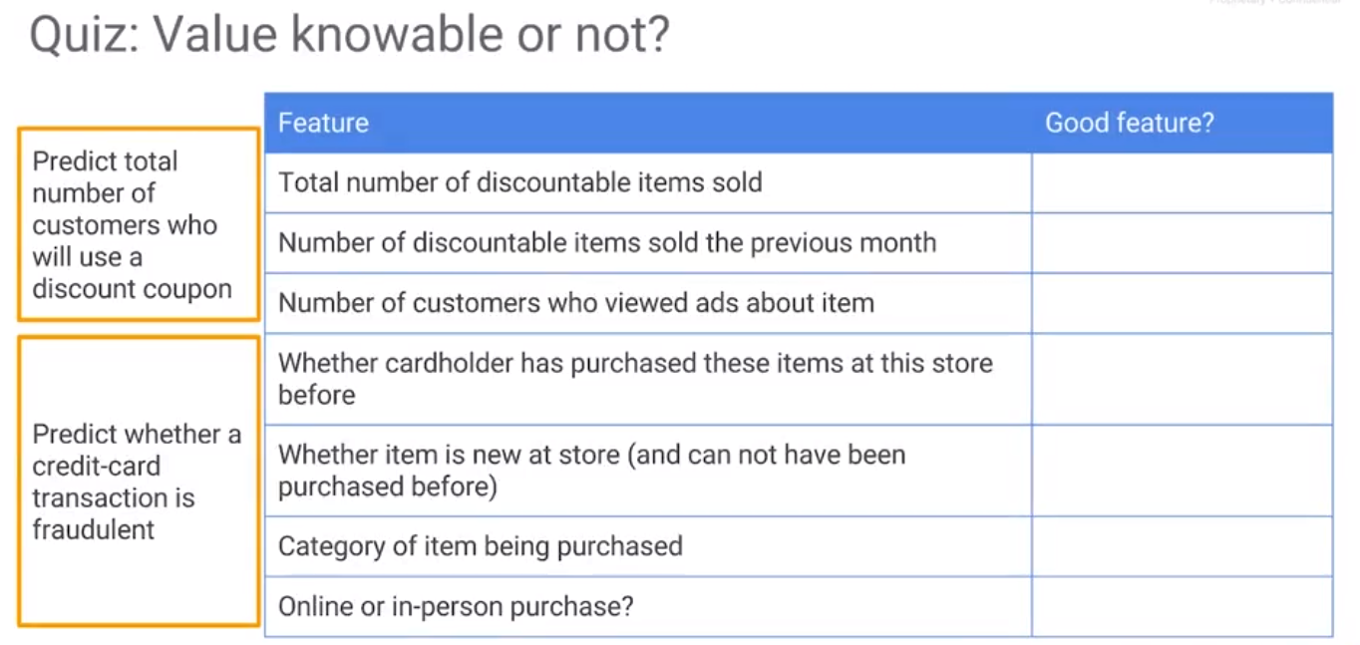
ML Feature Engineering
Machine Learning
vague
period?
period?
Train data up to CURRENT DATE, even for old data (Feb 9th →Feb 12^{th)}

Slide 37
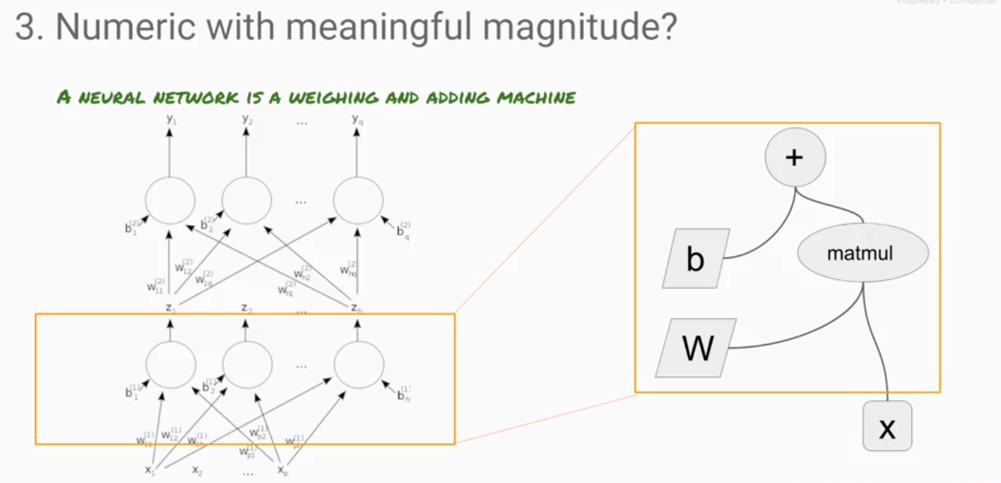
ML Feature Engineering
Machine Learning

Slide 38
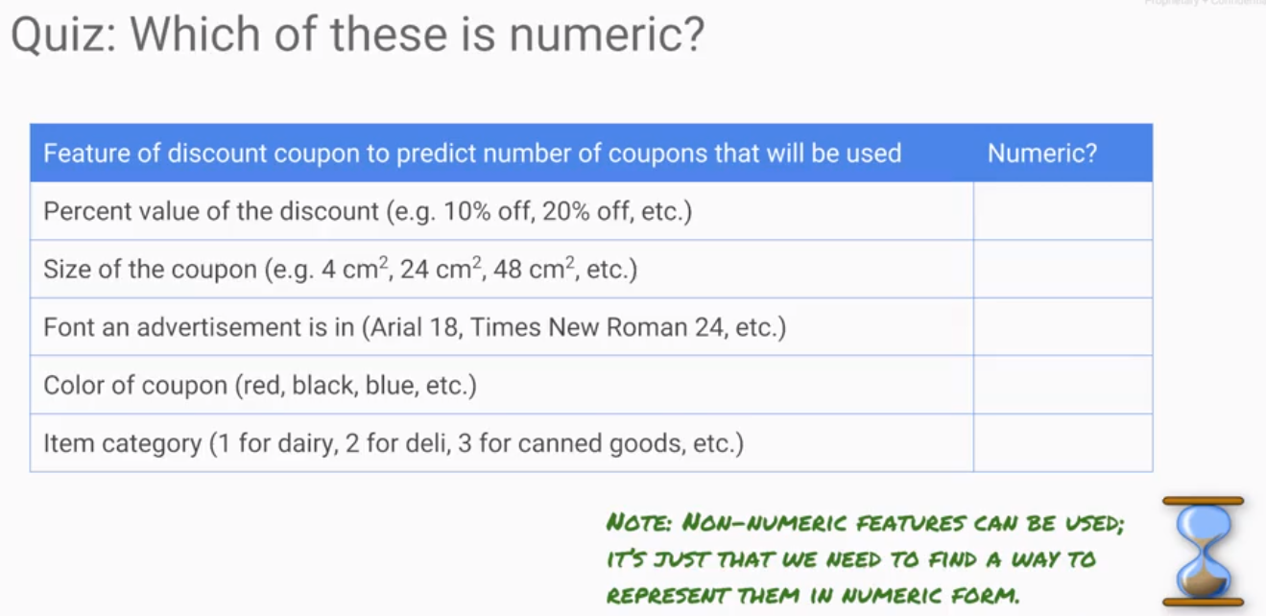
ML Feature Engineering
Machine Learning
Small, Median, Large?

Slide 39
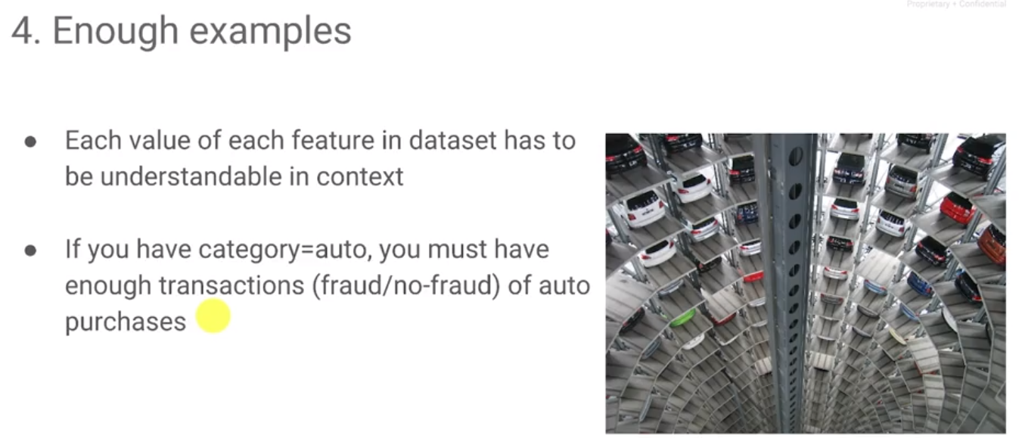
ML Feature Engineering
Machine Learning

Slide 40
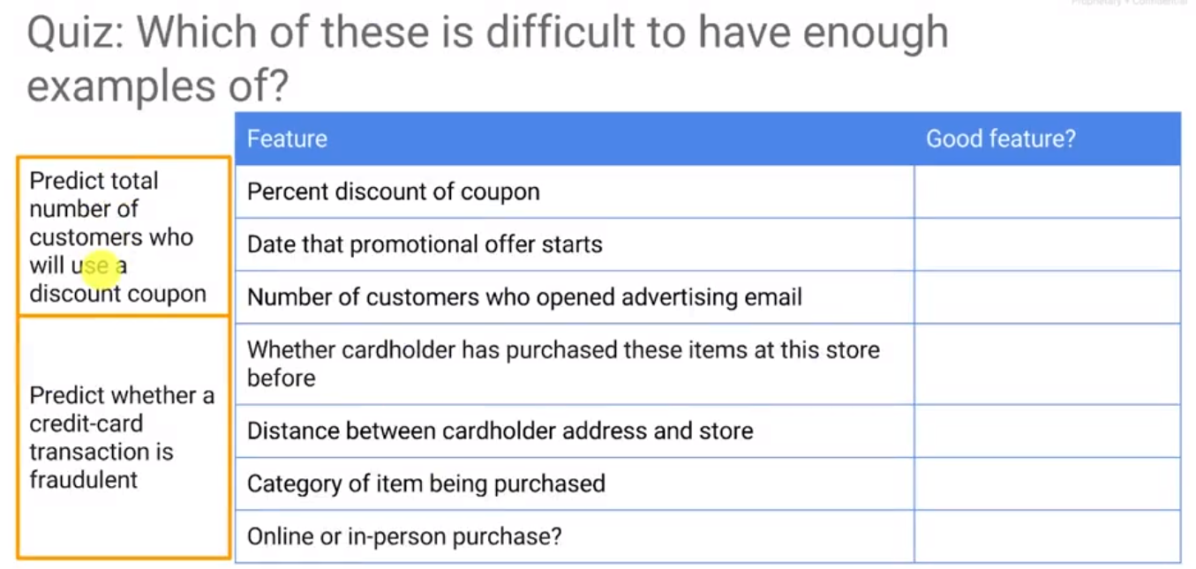
ML Feature Engineering
if have continuous numbers you may have to group them up,
discretization,
and then see if when discrete bins you have at least five examples of each bin
Machine Learning
VIP discount?
Every month?
Period? Ratio?

Slide 41
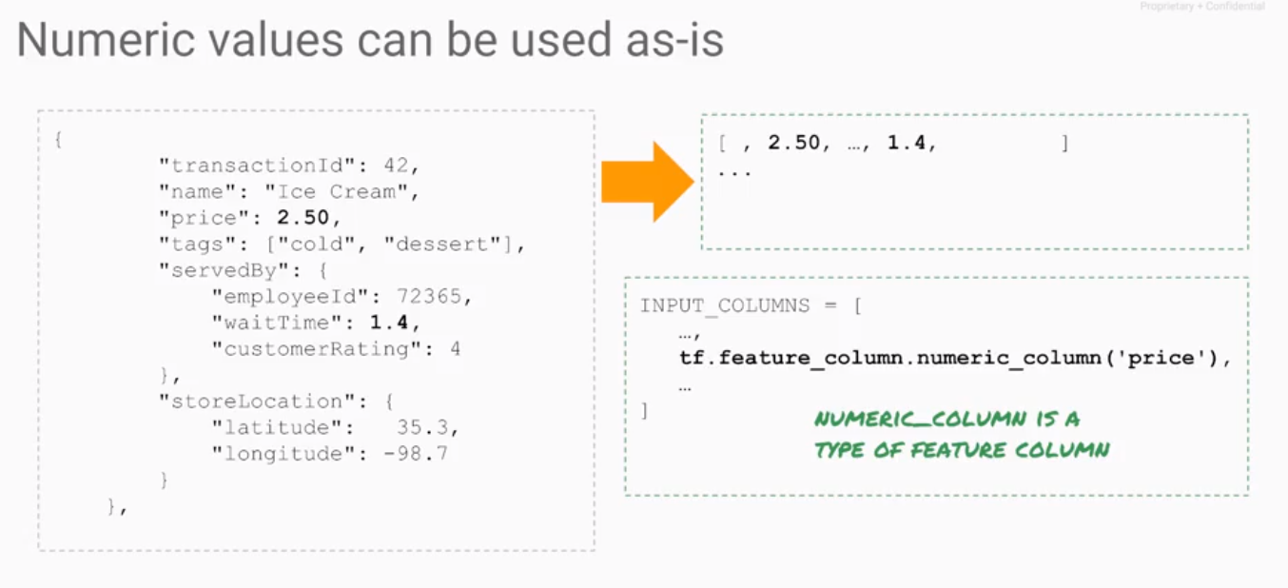
ML Feature Engineering
Machine Learning
Not a good feature

Slide 42
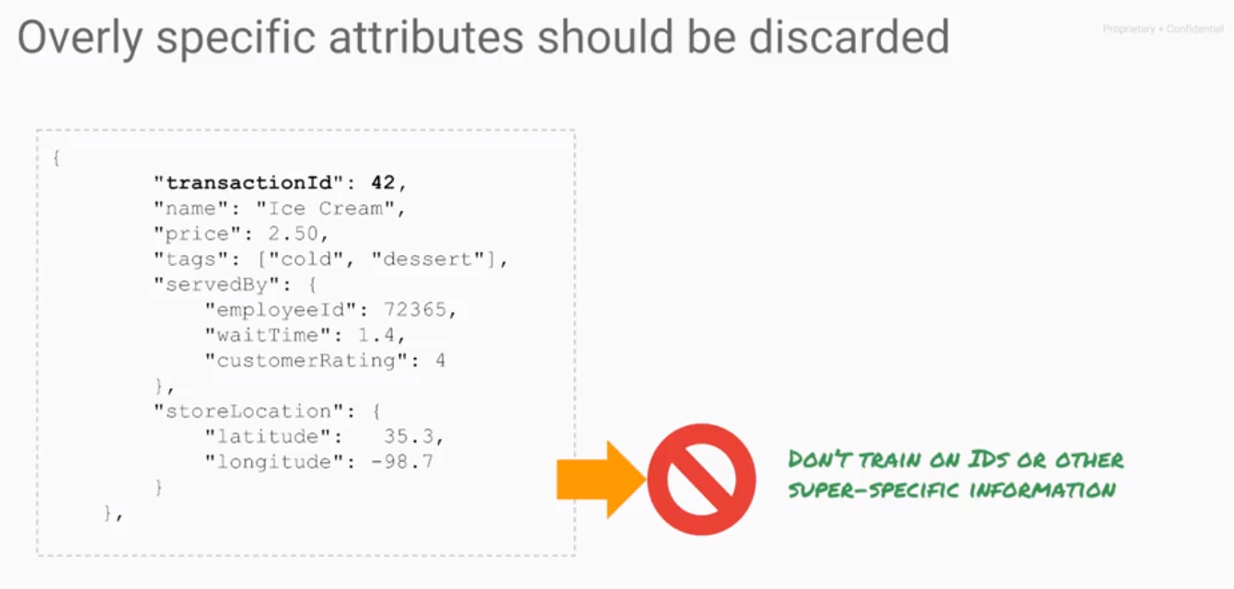
ML Feature Engineering
Machine Learning

Slide 43
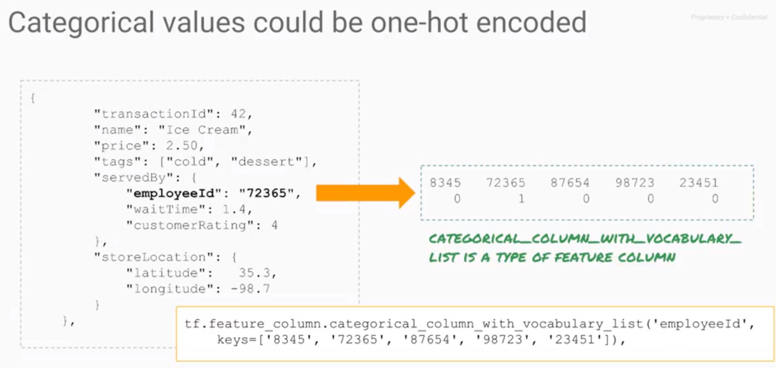
ML Feature Engineering
Machine Learning
Vocabulary list to One-hot encoding

Slide 44
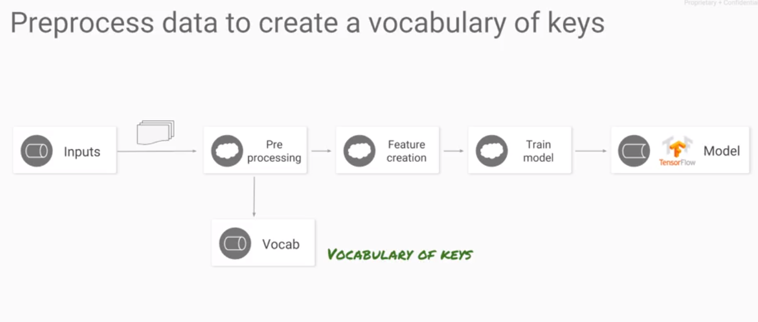
ML Feature Engineering
Machine Learning
Vocabulary list will be utilized in training/ validation/ prediction process It must be identical in all process

Slide 45
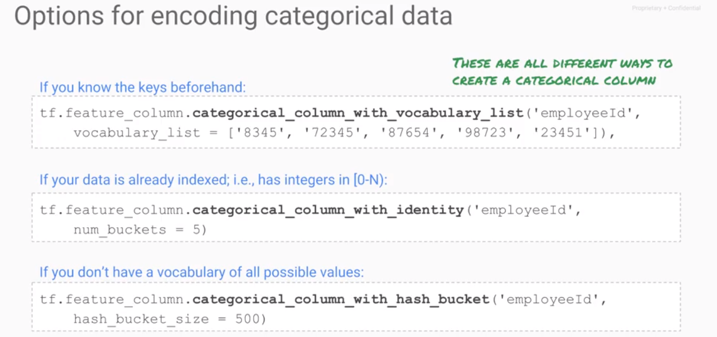
ML Feature Engineering
Machine Learning
Column sorting happen to be index, Date, Year, Month, Day, Hour
100employee, with 500 employee ID in 500 bucks, 20%

Slide 46
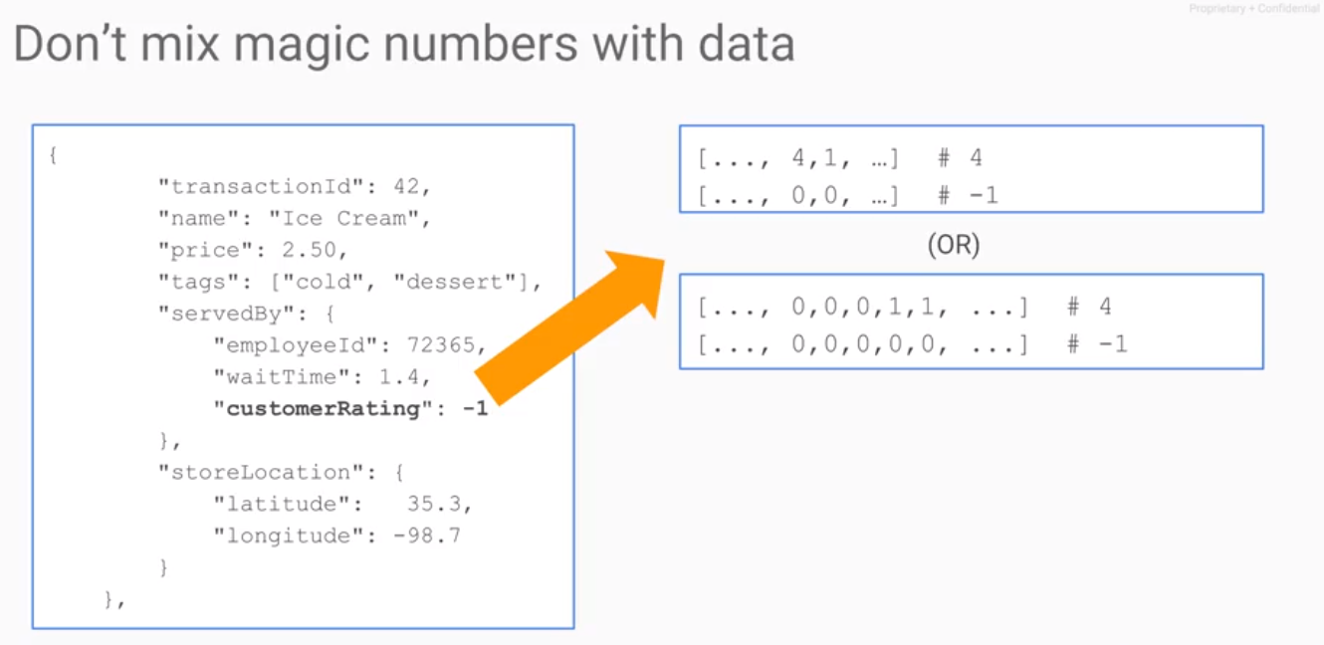
ML Feature Engineering
Machine Learning
Customer without rating
Rating as input feature.
Continuous number 1~5
Discrete One-Hot encoding the rating

Slide 47
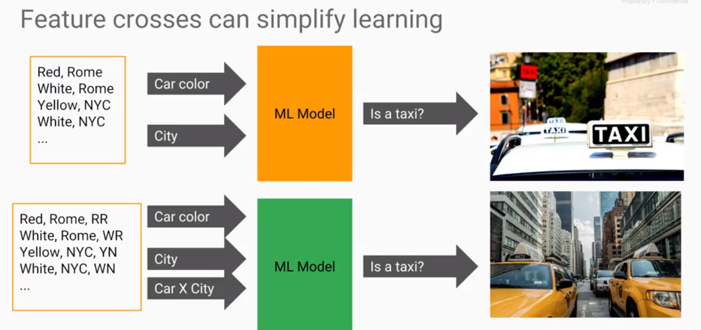
ML Feature Engineering
Machine Learning
Scalability for globalization enterprise

Slide 48
ML Feature Engineering
Machine Learning
Scalability for globalization enterprise, combine existing column to new feature

Slide 49
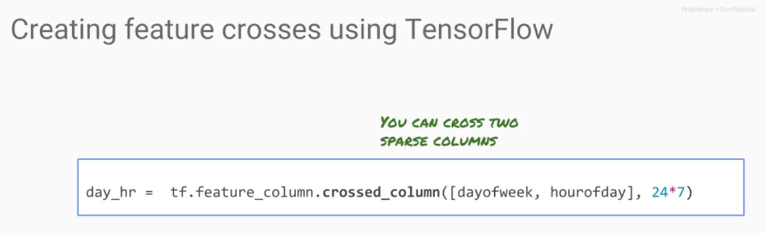
ML Feature Engineering
Machine Learning
Derived column by crossed_column for rush hour

Slide 50
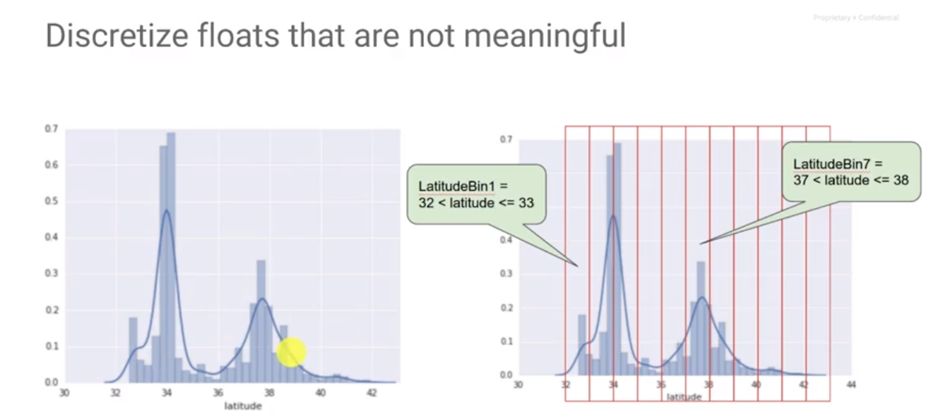
ML Feature Engineering
Machine Learning
Bucketize it as a BIN for categorical feature
feature_column.Bucketize_column

Slide 51
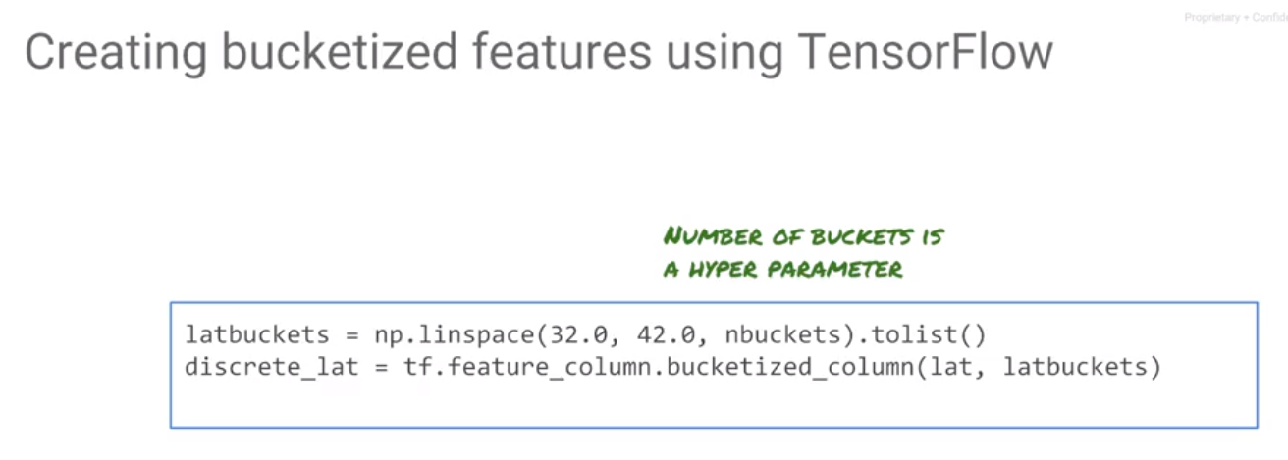
ML Feature Engineering
Machine Learning
boundaries

Slide 52
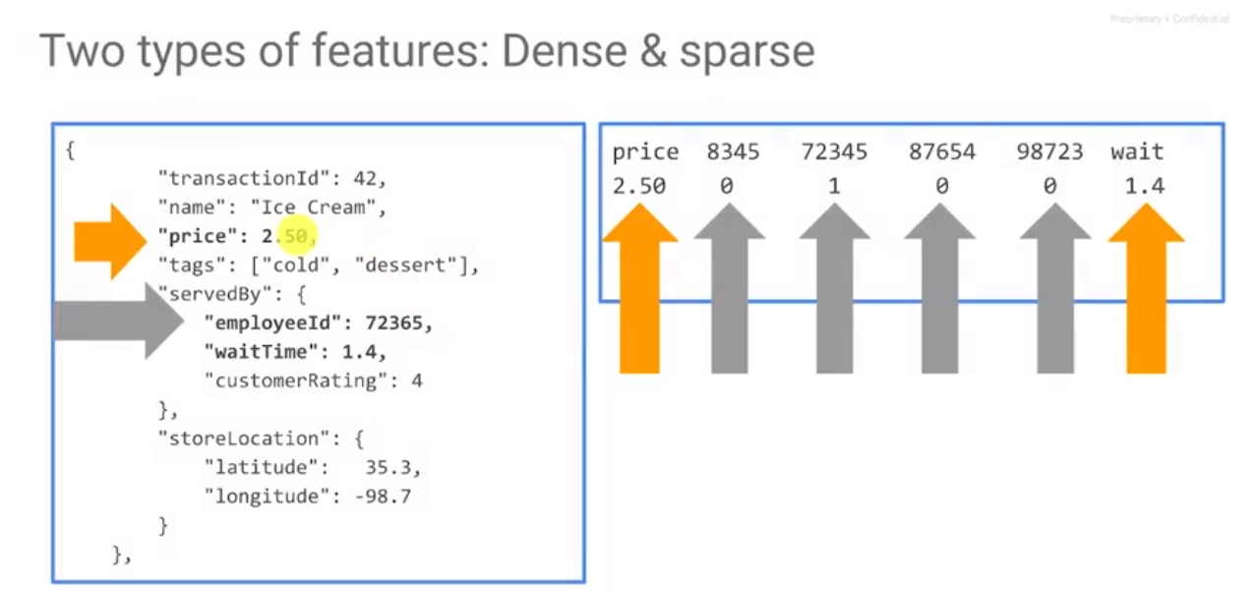
ML Feature Engineering
Machine Learning
Dence, One column
Sparse, On-hot encoded column
One-hot encoding

Slide 53
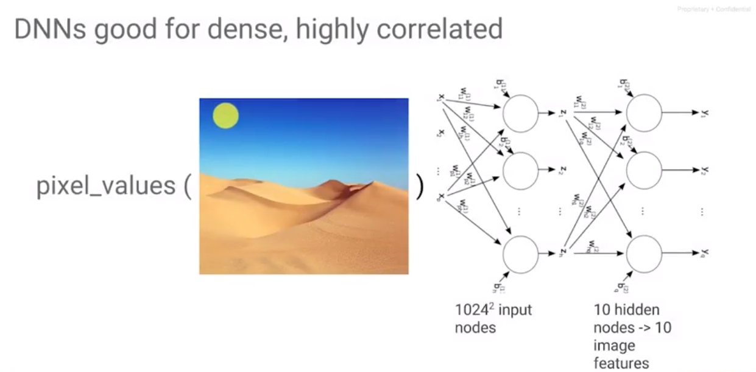
ML Feature Engineering
Machine Learning
R,G,B, dense or sparse
Pixels value are highly correlated to each other good for neural network computing

Slide 54

ML Feature Engineering
Machine Learning
Difficult for NN to deal with majority of derived column will close to 0

Slide 55

ML Feature Engineering
Machine Learning
Linear model works well for sparse features
In realities→MIX
NN model works well for dense features

Slide 56

ML Feature Engineering
Machine Learning
sparse column
Dense column
Layers , notes

Slide 57

ML Feature Engineering
Machine Learning
Preprocessing in 3 ways

Slide 58

ML Feature Engineering
Machine Learning
numpy linspace 等差數列

Slide 59

ML Feature Engineering
Machine Learning
ETL process

Slide 60

ML Feature Engineering
Machine Learning

Slide 61

string
Feature Engineering, Derived Column + North –South +East -West

Slide 62

Layer&Units
Friday_0300
Wide column, Sparse column, Linear
Deep column, Dense column, NN

Slide 63

Wide column, Sparse column, Continuous, Linear
Deep column, Dense column, Discrete, NN

Slide 64


Slide 65


Slide 66


Slide 67


Slide 68

ML Hyperparameter Tuning
Machine Learning

Slide 69

ML Hyperparameter Tuning
Machine Learning
Redundant column

Slide 70

ML Hyperparameter Tuning
Machine Learning
Tuning how many nbuckets and units do we need
Redundant column

Slide 71

ML Hyperparameter Tuning
Machine Learning
Adding this .yaml job into training job, .yaml file will automatically find the best parameters which result in minimum RMSE

Slide 72

ML Hyperparameter Tuning
Machine Learning
Extra feature by feature engineering
try to predict fare_amount
Extra feature by feature engineering North or South / East or West

Slide 73


ML Hyperparameter Tuning
Machine Learning
Buckitized for Categorical data
Grid-cell

Slide 74

Configuration
Wide column, Sparse column, Continuous, Linear
Deep column, Dense column , Discrete, NN

Slide 75

Dataflow pipeline code : process huge data in a distributed way
to the taxi_preproc Bucket
Execute this query from BigQuery, output as a csv file

Slide 76

ML Feature Engineering
Machine Learning

Slide 77

ML Feature Engineering
Machine Learning

Slide 78


Slide 79


Slide 80



Slide 81



Slide 82

ML Feature Engineering
Machine Learning

Slide 83


